Slide 1
LEVI GACHANJA
Kenya Paye Calculator

Slide 2
PROBLEMS
Difficult in NSSF calculation.
Low performance.
Difficulty in net to gross calculations.
Lack of referrals.

Slide 3
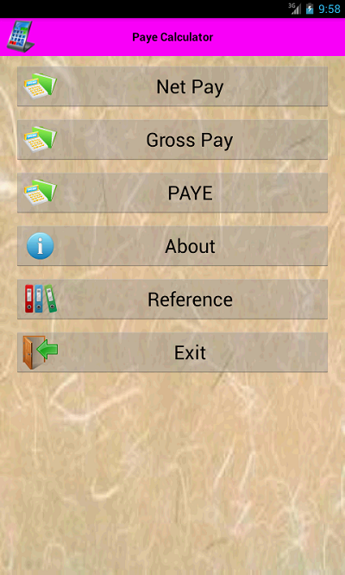
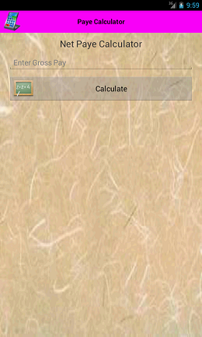
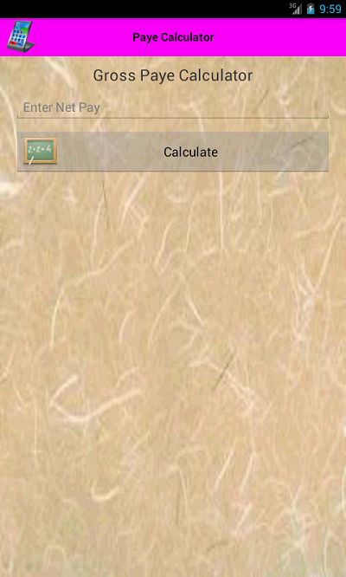
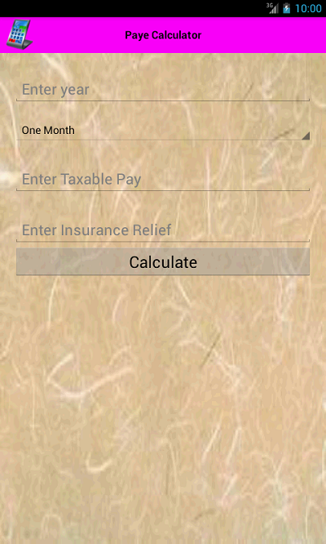
SOLUTION

Slide 4
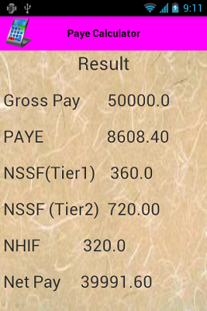
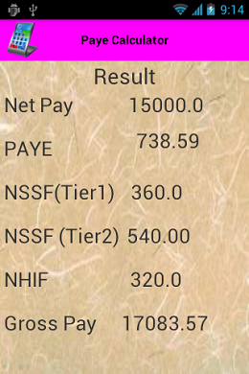
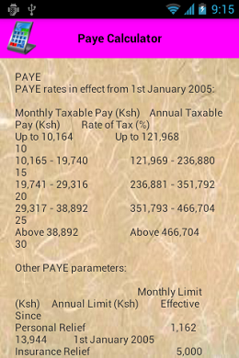
SOLUTIONS

Slide 5
TARGET MARKET
The application is targeting the accountant in rural areas.
The application will be marketed through the google store, friends and advertisements.
The application has competitors like Kra Calculator in Kenya were by the calculator only does the gross to net calculation and registration of the Kra pin. The application does gross to net calculations, net to gross calculations and Paye were by you see the way the deductions are done.

Slide 6
REVENUE MODEL
The application will be sold through different application stores and for each download will charged KES 50.00

